Slide 1

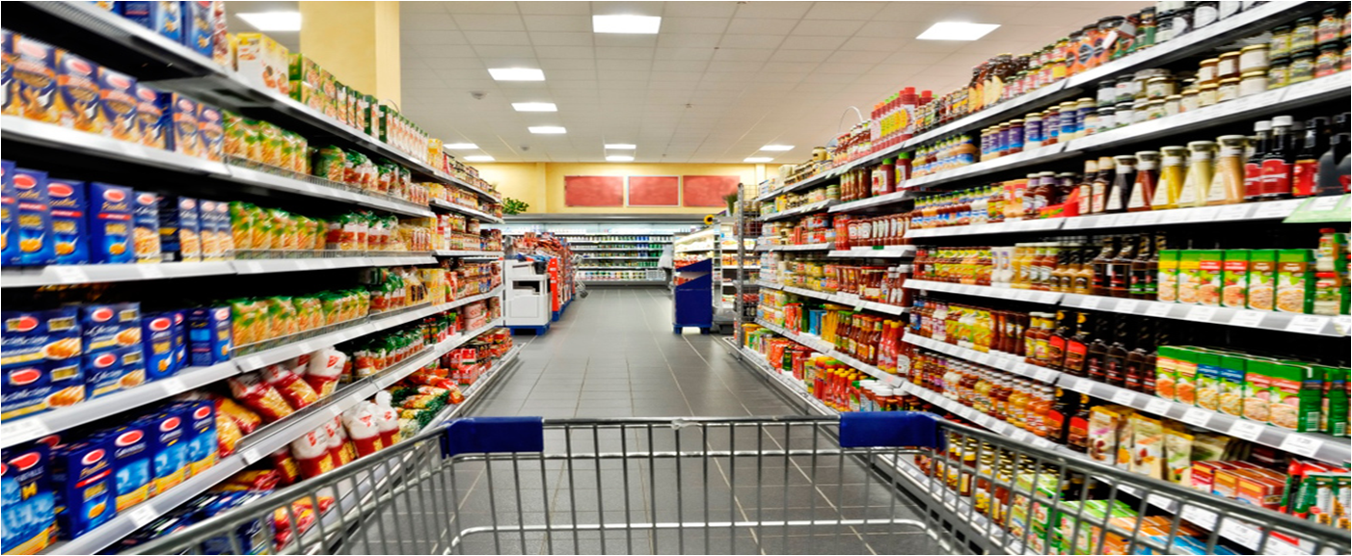


Super Mart Sales Analysis
A Research Project by SAHIL KUMAR
Notes:
Hello, This is Tanusree Mondal. I have done masters in economics from Calcutta University. Currently, I'm enrolled in a data analytics course at Ivy Professional School. As a part of this course, I am going to present a research project which is focused on the retail industry within a small UK neighborhood. This presentation aims to explore the intricacies of this case study, addressing industry challenges, conducting analysis, and proposing solutions.

Slide 2

CONTENT
Introduction
Current Sales Performance
Market Analysis
Inventory and Product Management
Sales Strategies
Customer Engagement
Operational Efficiency
Recommendations
Notes:
This page shows a glimpse of what I am going to present next. I'll begin by providing an overview of the case background, followed by an analysis of the key findings, and finally, we'll discuss the implications and recommendations.

Slide 3
CASE STUDY
This case study examines how Super Mart leveraged data analytics to identify underperforming product categories and implemented targeted promotions that increased sales by 15% over months. By optimizing inventory and enhancing customer engagement through personalized marketing, the store improved both customer satisfaction and overall profitability.
Notes:
To work on this case, I have collected secondary datasets from online sources. So, we have three datasets, namely features, sales, and stores- that captures different aspects of retail store sale performance in a UK neighborhood. Features shows the data of different independent variables like promotional expenses done by the stores, avg temperature of the week, and macroeconomic factors like consumer price index, unemployment and fuel price from 2020-2022. Sales dataset consists of weekly sales data 45 UK neighborhood stores for the same period. And lastly, the stores dataset consists of information about the type and size of these stores.

Slide 4
OBJECTIVES
The objective of this presentation is to analyz current sales performance, identify key growth opportunities, and propose actionable strategies to increase revenue. It aims to optimize inventory management, enhance customer engagement, and improve overall operational efficiency to drive long-term profitability.
Notes:
This research aims to assess how macroeconomic indicators and promotional strategies employed by retail stores impact their weekly sales. Subsequently, I intend to offer recommendations to these businesses on enhancing their sales performance through optimization.

Slide 5
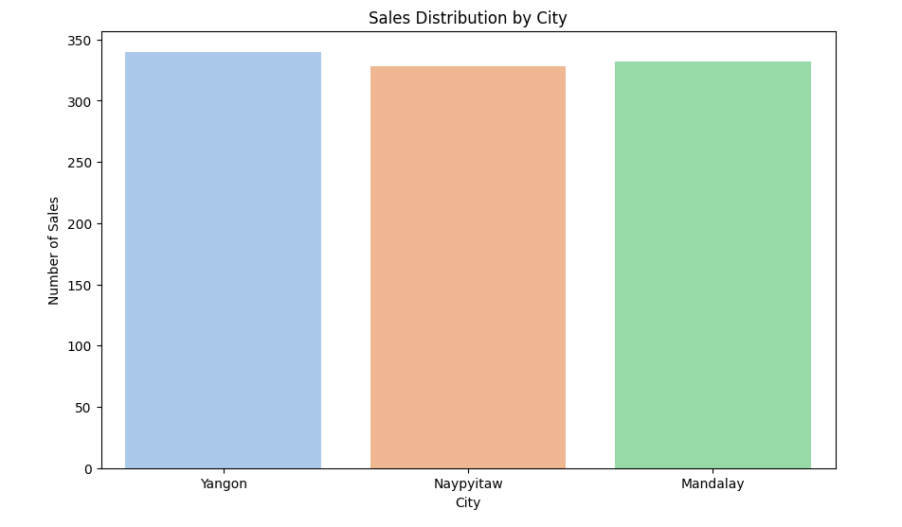
Sales Distribution by city
Chart displays sales distribution across three Myanmar cities: Yangon, Naypyitaw, and Mandalay. Yangon leads with about 340 sales, followed closely by Mandalay (335) and Naypyitaw (330). The chart shows relatively uniform sales performance across these major urban centers, with only slight variations between them.
Notes:
For this, first I have done some trend analysis to understand the Weekly Sales of 45 UK stores from 2020 to 2022 has been depicted through the line charts. This charts indicate a lower volatility in weekly sales for the years 2020 and 2021 compared to 2022. A typical pattern of sales can be observed from these charts. The weekly sales typically rose from March to April and declined in September to October, followed by a year-end increase.

Slide 6
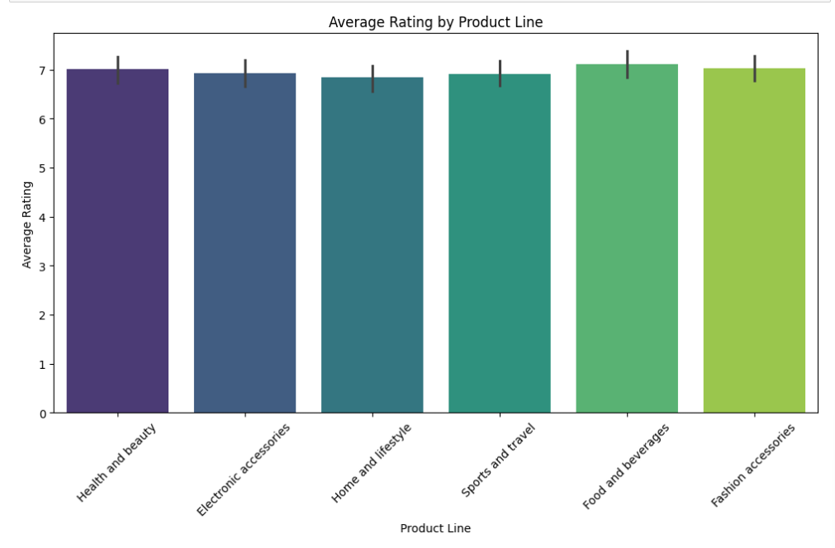
Average Rating by Product Line
chart displays the average ratings for six different product lines. All product categories have high ratings between 6.9 and 7.1 out of 10, Fashion accessories and Food and beverages show slightly higher ratings, while Health and beauty has the lowest, but differences are minimal. Error bars indicate some variation within each category. Overall, the chart suggests consistently positive customer satisfaction across all product lines.
Notes:
Over the past three years, average sales have declined. The weekly sales data shows a substantial standard deviation. This indicates that these stores have experienced notable fluctuations in sales during this period. Also it has been noted that more than 50% of these stores are consistently underperforming.

Slide 7
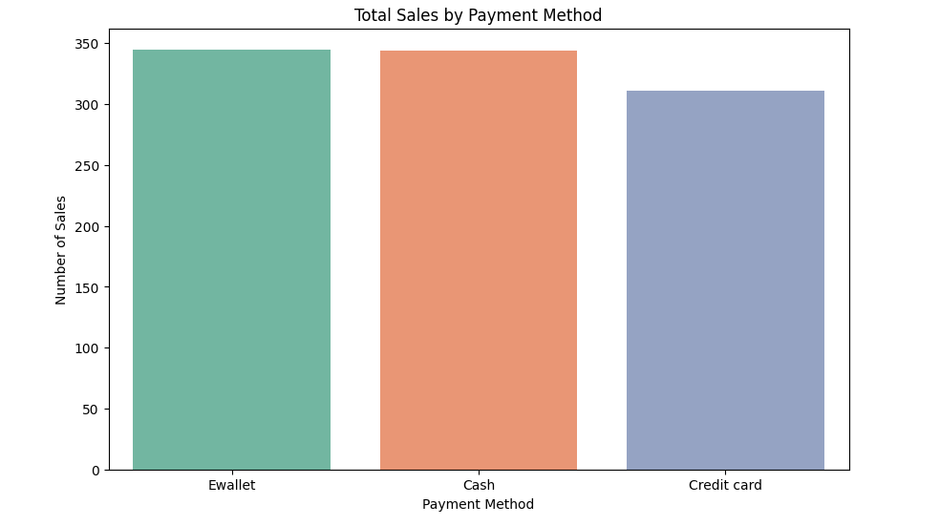
Total Sales by Payment Method
This bar chart illustrates the total sales by payment method. E-wallet leads with approximately 345 sales, followed closely by cash at around 340 sales. Credit card shows the lowest number of sales at about 310. The chart uses different colors for each payment method and clearly displays the number of sales on the y-axis, providing a quick visual comparison of payment preferences among customers.
Notes:
To address the business problem, we need to comprehend the independent factors that can influence the sales of a physical store. Some of these factors, which have been addressed in this case study, include the average weekly temperature, holidays, promotional activities implemented by store owners, and the macroeconomic conditions of the country, such as fuel prices, the unemployment rate, and the consumer price index.

Slide 8
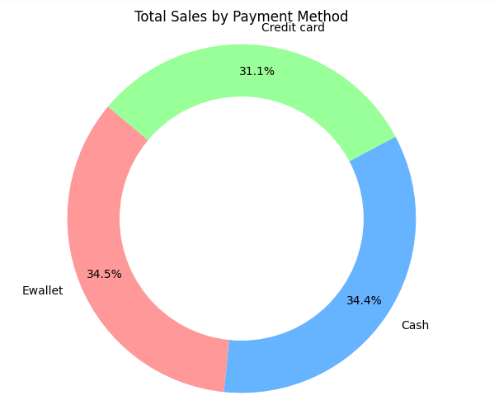
Total sales by Payment Method
This donut chart displays the distribution of total sales by payment method. E-wallet is the most popular at 34.5%, followed closely by cash at 34.4%. Credit card transactions account for 31.1% of sales. The chart uses distinct colors for each payment method and shows percentages, offering a clear visual representation of the relative popularity of each payment option.
Notes:
I carried out a correlation analysis to see how average temperature of the week and the macroeconomic indicators like the CPI, unemployment rate, fuel prices relate to store sales performance. The findings suggest that these independent variables don't have a major impact on the variations in sales

Slide 9
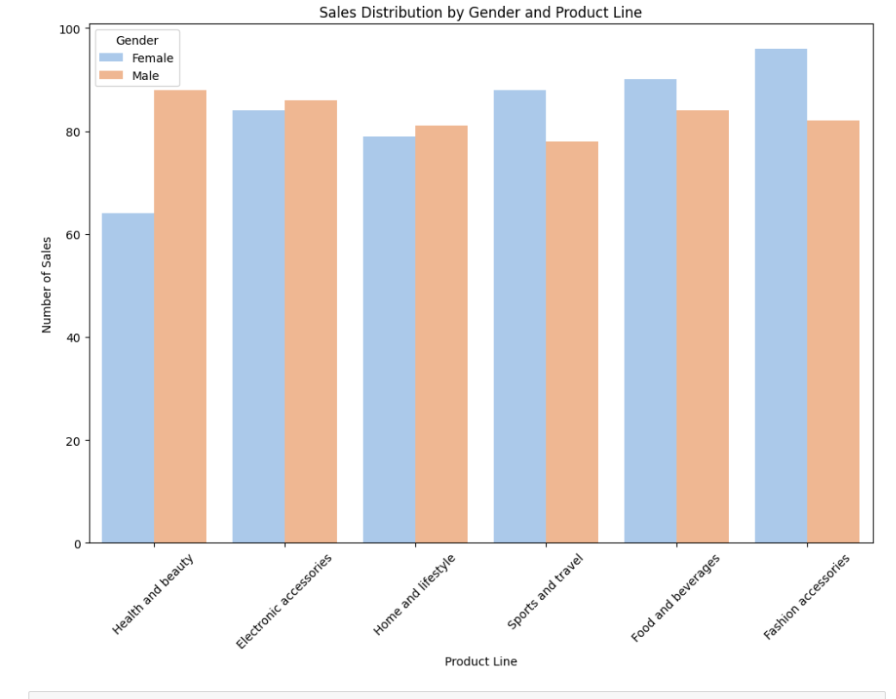
Sales Distribution by Gender and Product line
This bar chart displays sales distribution across six product lines, comparing female and male customers. Light blue bars represent female sales, while orange bars show male sales. The y-axis indicates number of sales, ranging from 0 to 100. Fashion accessories have the highest female sales, while health and beauty products lead for males. Overall, the chart reveals gender-based preferences across different product categories..
Notes:
A regression analysis was conducted to understand how promotional activities affect the sales performance of these retail stores. The results showed a statistically significant and positive impact of these activities on sales performance. However, it's worth noting that promotional activities account for only a small part of the total variation in sales.

Slide 10
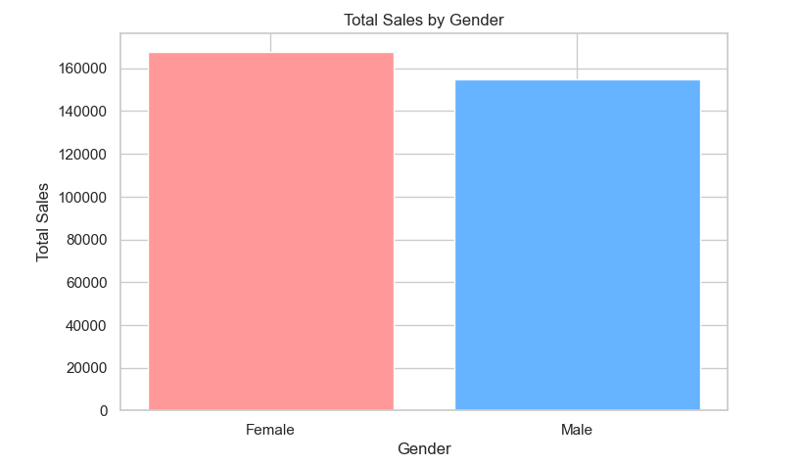
Total Sales by Gender
This bar chart compares total sales between female and male customers. The pink bar represents female sales, while the blue bar represents male sales. Female sales are marginally higher than male sales, though both are substantial, exceeding 140,000 units each. The y-axis measures total sales and is scaled in increments of 20,000, ranging from 0 to 160,000.
Notes:
This bar chart categorizes the average weekly sales in these stores, distinguishing between weeks with holidays and weeks without holidays over a three-year period. It's evident that these stores generate higher sales revenue during weeks with holidays compared to those without any holiday.

Slide 11
RECOMMENDATIONS
Optimize Inventory: Implement better forecasting and inventory management to reduce costs and avoid stockouts.
Enhance Sales Strategies: Focus on targeted promotions, product bundling, and personalized marketing to increase sales.
Improve Operational Efficiency: Upgrade technology and staff training to streamline operations and boost customer satisfaction.
Notes:
The foremost recommendation is to implement discount schemes, combo offers, and free gift vouchers for customers during holiday weeks. Promotional activities should be strategically scheduled for the months of January-February and September-October. The stores displaying consistent underperformance warrant thorough investigation and strategic intervention by their respective leadership teams to identify the root causes. If these stores consistently experience high customer traffic, it is advisable to consider expanding their physical footprint.

Slide 12




Thank You
Notes:
Thank you for giving me this opportunity to present this case study.

